Slide 1
Markov Model

Slide 2
Introduction
A markov model is a stochastic model used to model randomly changing system.
It is assumed that future state depends on the current state, not on the events that occurred before.
It is used for sequential data prediction.

Slide 3
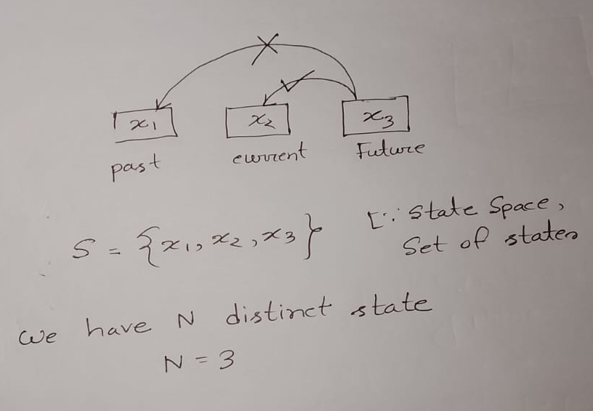

Slide 4
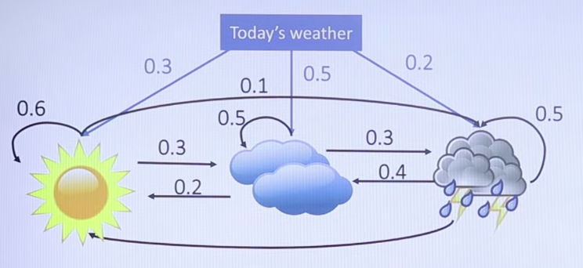
Initially weather

Slide 5
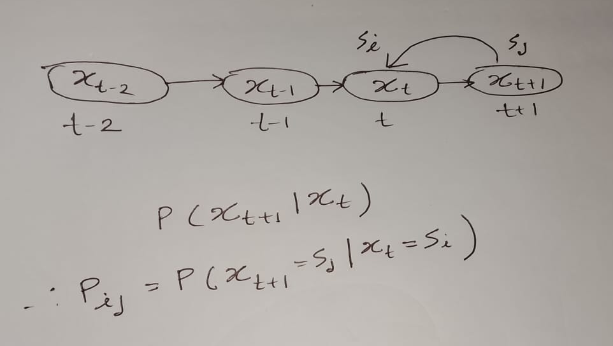
Markov Chain
Any chain of event that follow the markov property that chain is called markov chain.

Slide 6
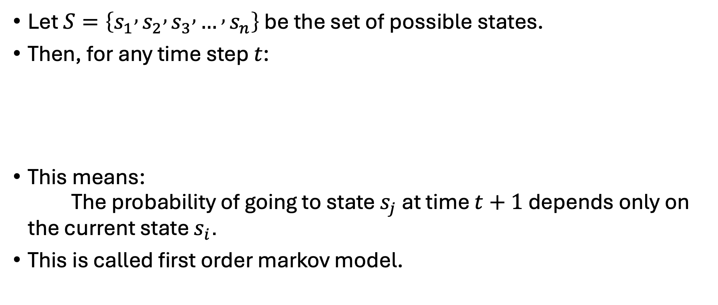
Mathematical Definition
Let $S=\left\{s_{1} , s_{2} , s_{3} , … , s_{n}\right\}$ be the set of possible states.
Then, for any time step $t$:
This means:
The probability of going to state $s_{j}$ at time $t+1$ depends only on the current state $s_{i}$.
This is called first order markov model.

Slide 7
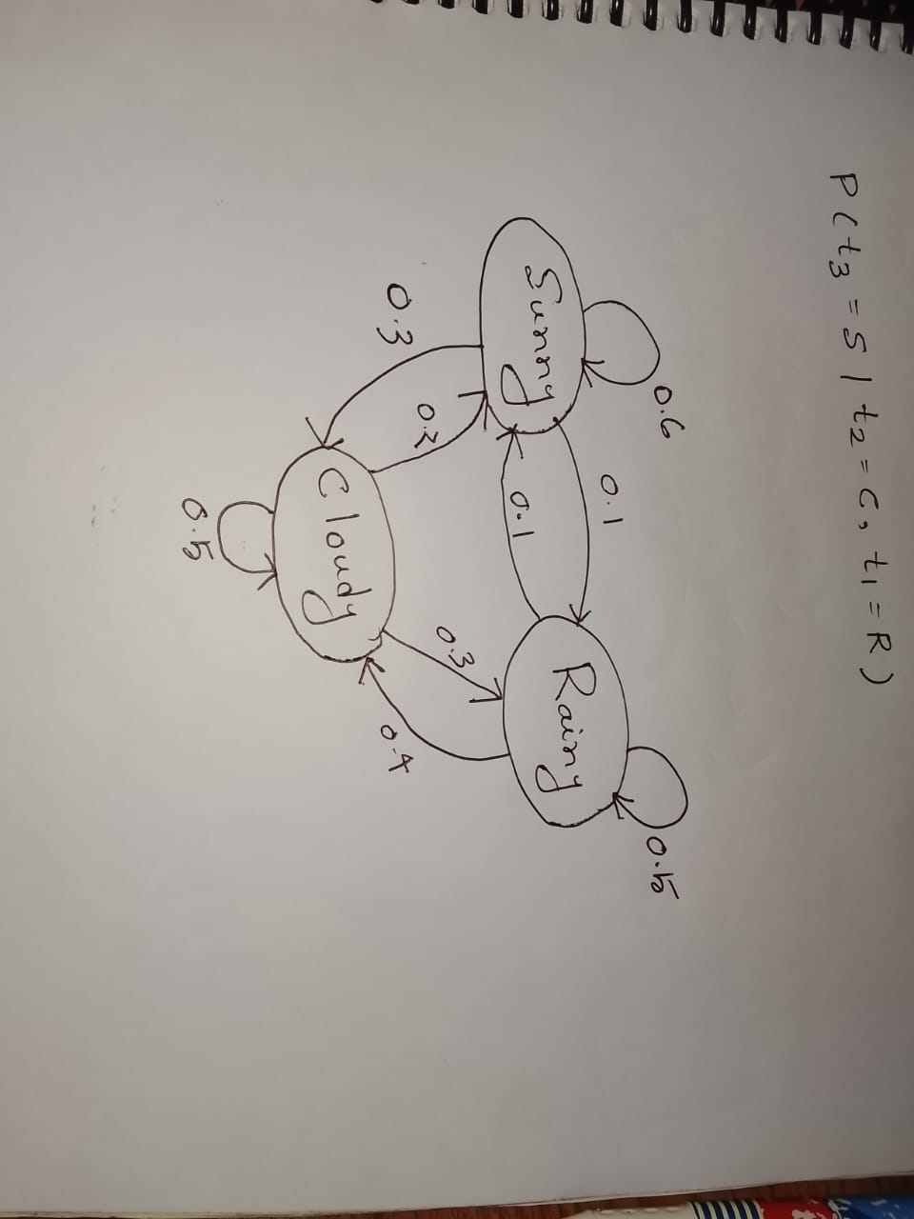
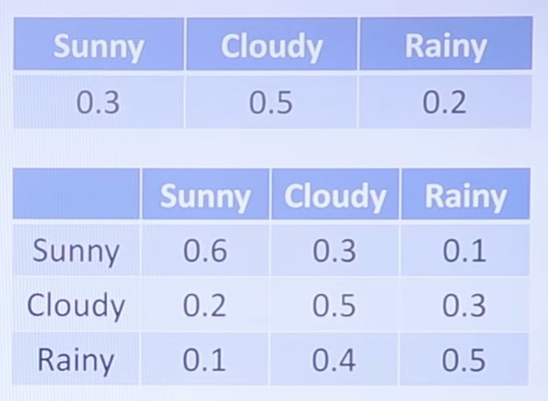
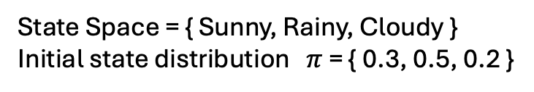
Transition Matrix Example
State Space = { Sunny, Rainy, Cloudy }
Initial state distribution $π$ = { 0.3, 0.5, 0.2 }
Transition Matrix
Future State
Present state
State Transition Diagram
Transitional probability

Slide 8
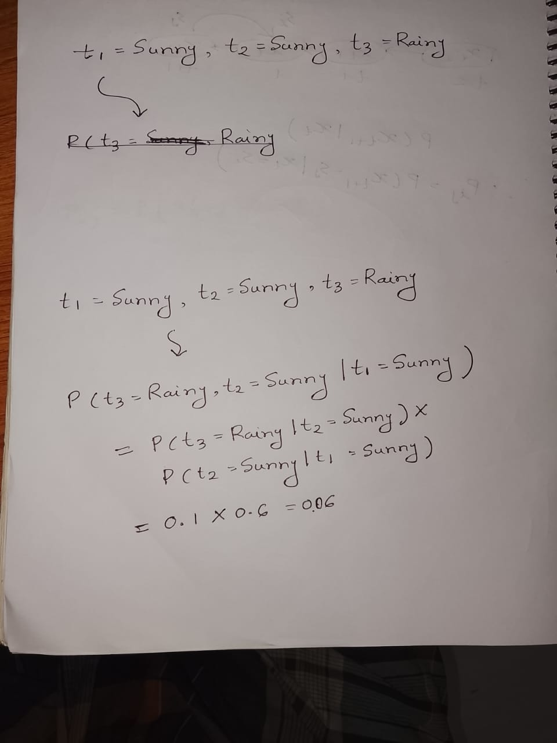
Question 1
Given that today the weather is sunny, what is the probability that tomorrow is sunny and day after is raning?
Solution:

Slide 9
Question 2
Given that today the weather is cloudy and yesterday was rainy, what is the probability that tomorrow would be sunny?

Slide 10
Question 3
What is the probability of given series?
  Sunny -> Rainy -> Rainy -> Rainy -> Cloudy -> Cloudy
Solution:
  P(S) * P(R | S) * P (R | R) * P (R | R) * P ( C | R) * P ( C | C )
  = 0.3×0.1×0.5×0.5×0.4×0.5 = 0.0015

Slide 11
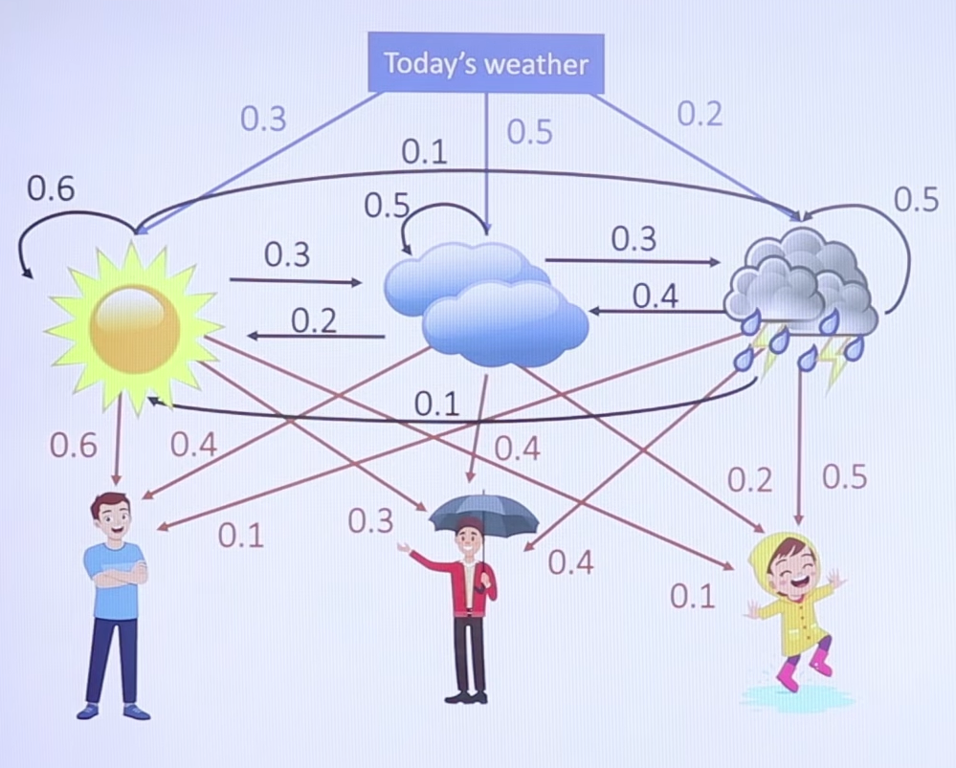
Hidden Markov Model
Initially weather
Hidden
layer
Observation
layer

Slide 12
Hidden Markov Model (Cont’d)
It is a statistical model that is used to describe the probabilistic relationship between a sequence of observations and a sequence of hidden states.
An HMM consists of two types of variables:
  The hidden states are the underlying variables that generate the observed data, but they are not directly observable.
  The observations are the variables that are measured and observed.
HMMs are widely used in speech recognition, natural language processing, bioinformatics, and many other fields.

Slide 13
Hidden Markov Model (Cont’d)
The Hidden Markov Model (HMM) is the relationship between the hidden states and the observations using two sets of probabilities: the transition probabilities and the emission probabilities.
  The transition probabilities describe the probability of transitioning from one hidden state to another.
  The emission probabilities describe the probability of observing an output given a hidden state.

Slide 14
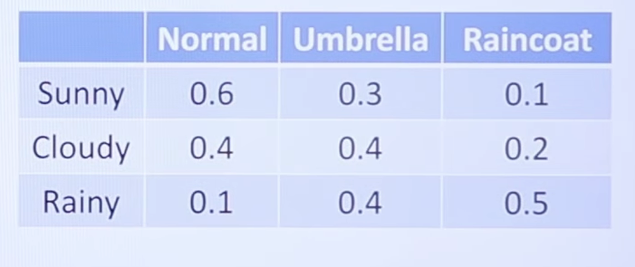

Initial state distribution $π$
Initially weather
Transition Matrix
Emission Matrix

Slide 15

Hidden Markov Model (Cont’d)
Transition Matrix
Initial state distribution $π$
Emission Matrix
Model
Observable
state
Hidden state

Slide 16
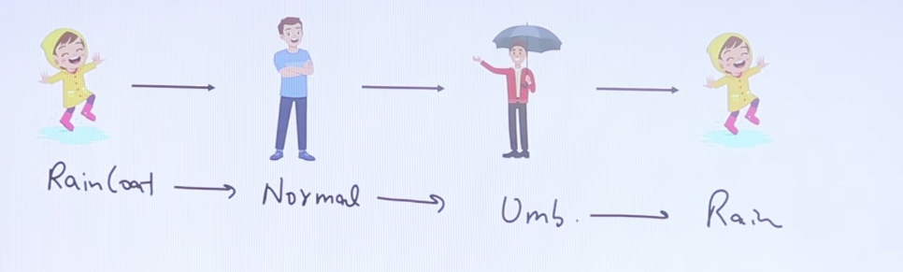
N = No of hidden state = 3
T = Given no of observation = 4
Total no of combination = N^{T} = 3⁴ = 81

Slide 17
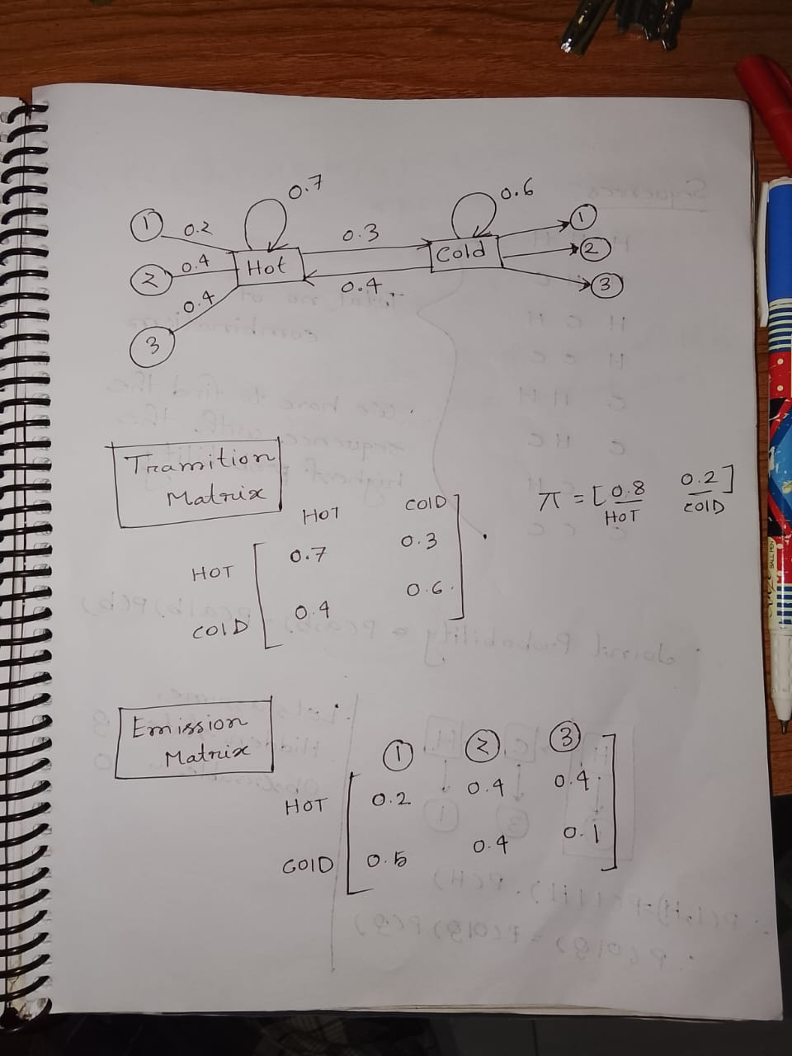
Question 1
If the observable state is (1, 3, 1) find the hidden state
0.5
0.4
0.1
Initial state for hot and cold = {0.8 , 0.2 }

Slide 19
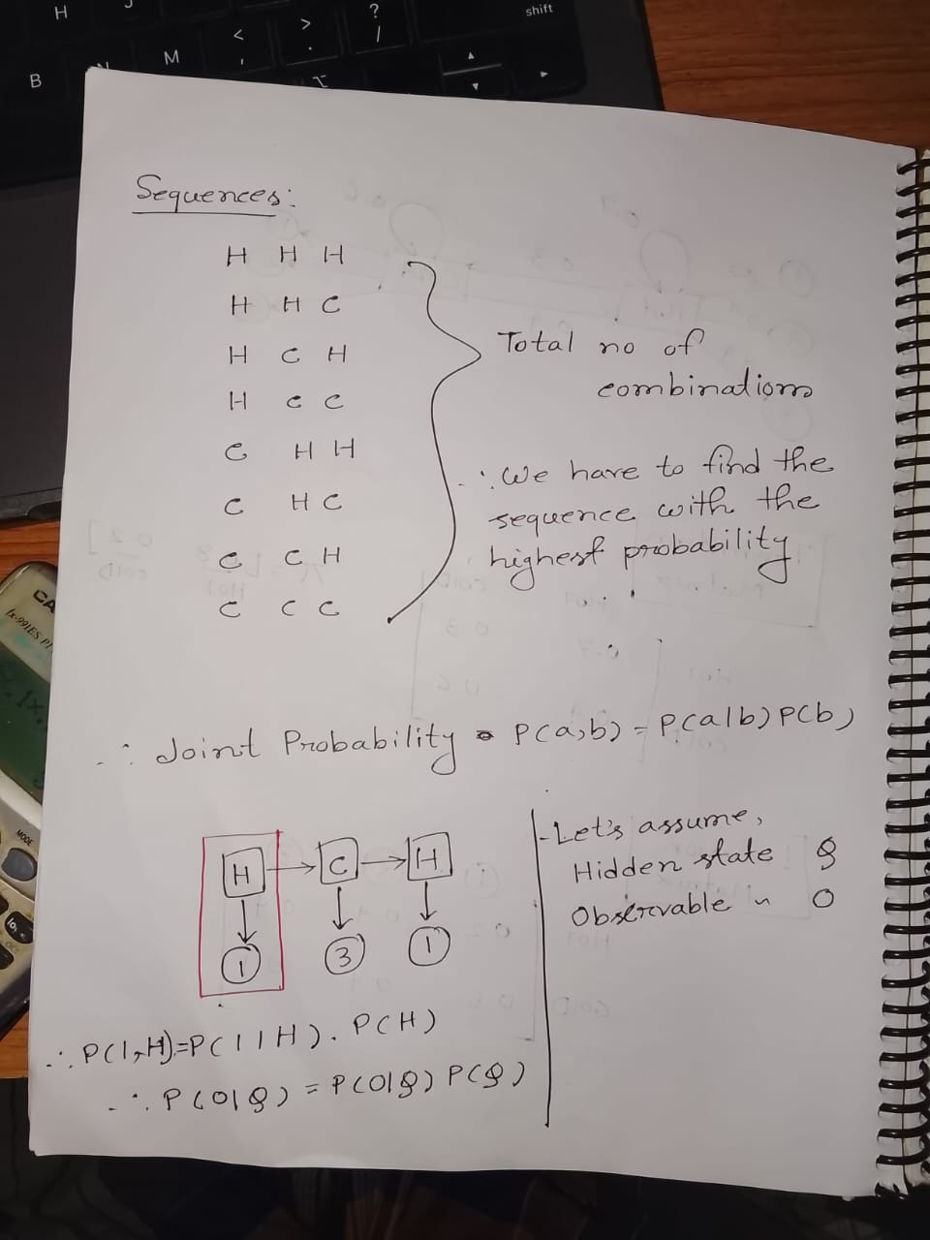

Slide 21
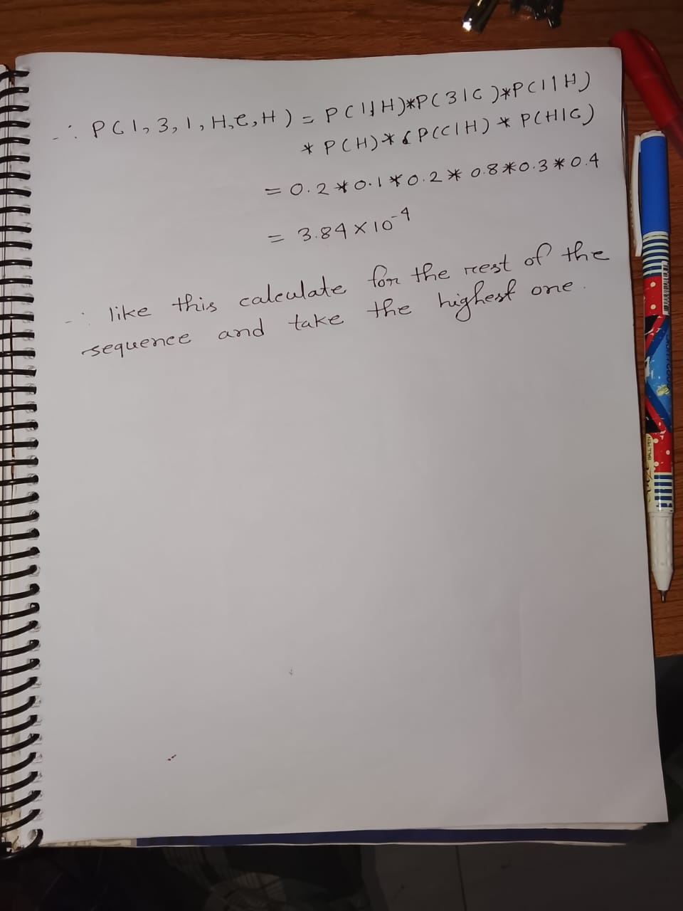

Slide 22
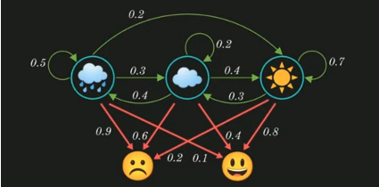
Question 2
Suppose, the state of emotion(Happy or Sad) is dependent on the weather(Sunny, Cloudy, Rain)

Slide 23
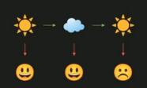
Now if probability of weather being Sunny is 50.90% then what is the probability of occurrence of the following series of event?
Given P(S) = 50.90%, then what is the joint probability of the observed mood given the weather sequence below?
P(Y=H,H,S , X=S,C,S)

Slide 24
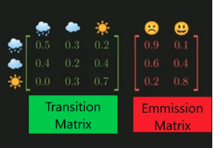


Slide 25
Need for Viterbi Algorithm
It is based on dynamic programming.
Dynamic programming breakdowns the problems into sub-problems.
It saves the result for future purposes therefore don’t need to compute the result again.

Slide 26
Viterbi Algorithm Steps
Step 1: Initialization
  Start at the first observation
  For each possible state, calculate its probability
  Remember which state you're in
Step 2: Forward Pass (Moving Through Time)
  Move to the next observation
  For each possible state at this time:
    Look at all states from the previous time
    Find which previous state gives the highest probability of reaching the current state
    Multiply by the probability of producing the current observation
    Keep track of the best previous state (this is your "breadcrumb")

Slide 27
Viterbi Algorithm Steps
Step 3: Repeat
  Repeat Step 2 for all remaining observations
  At each time step, always keep only the best path to each state
  Continue until you reach the last observation
Step 4: Find the Best Final State
  Look at all possible states at the final time
  Choose the one with the highest probability
  This is the end of your best path
Notes:
Viterbi-তে breadcrumb মানে:
প্রতিটি state-এ পৌঁছানোর সময় মনে রাখা যে আগের কোন state থেকে এসেছি

Slide 28
Viterbi Algorithm Steps
Step 5: Backtrack to Find Full Path
  Start from the best final state you just found
  Follow the breadcrumbs backward
  At each step, look at which previous state you marked as "best"
  Continue until you reach the beginning
  This gives you the complete most-likely sequence of states

Slide 29
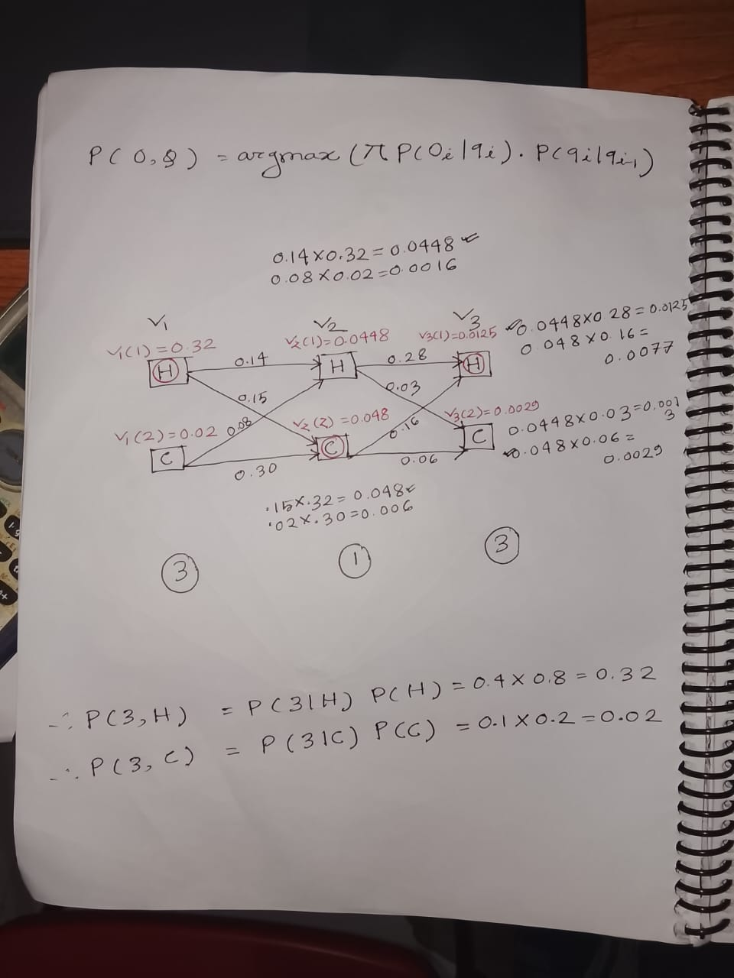

Slide 30
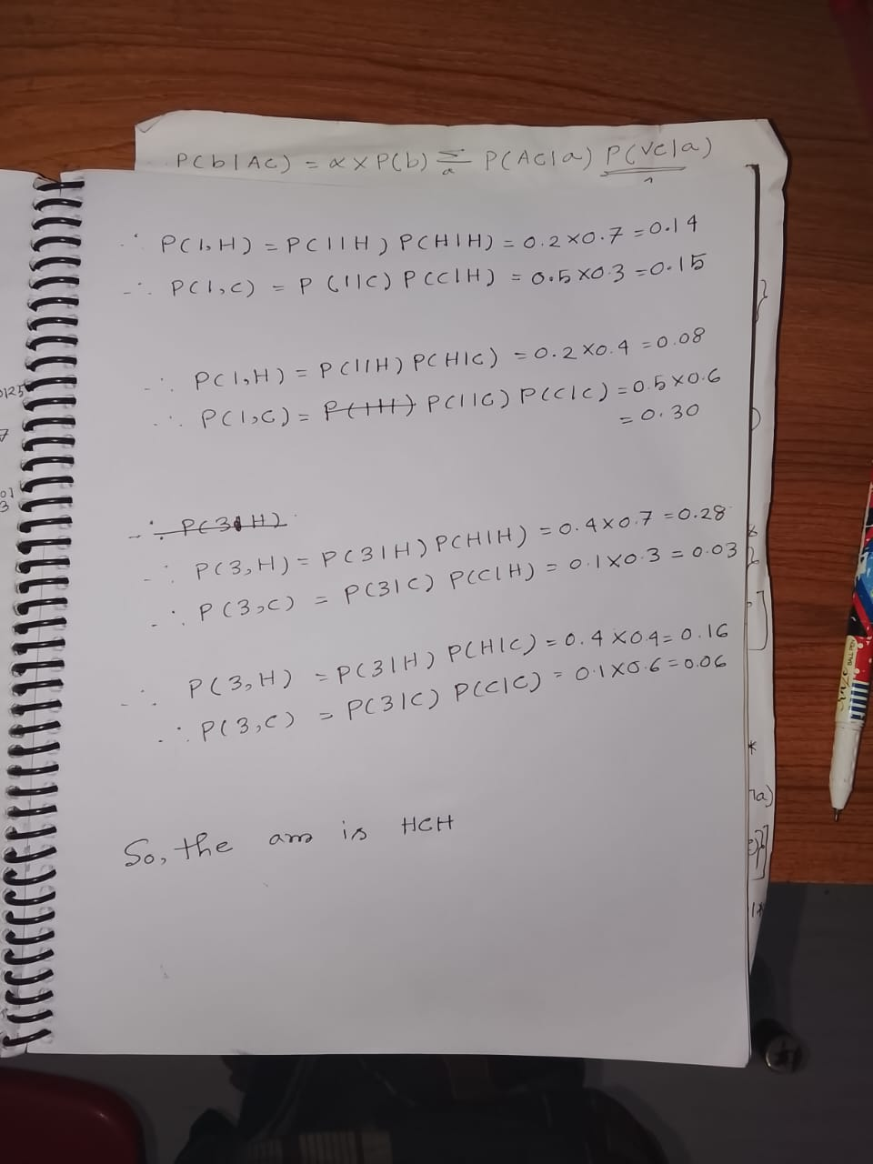

Slide 31
So, the ans is HCH

Slide 32
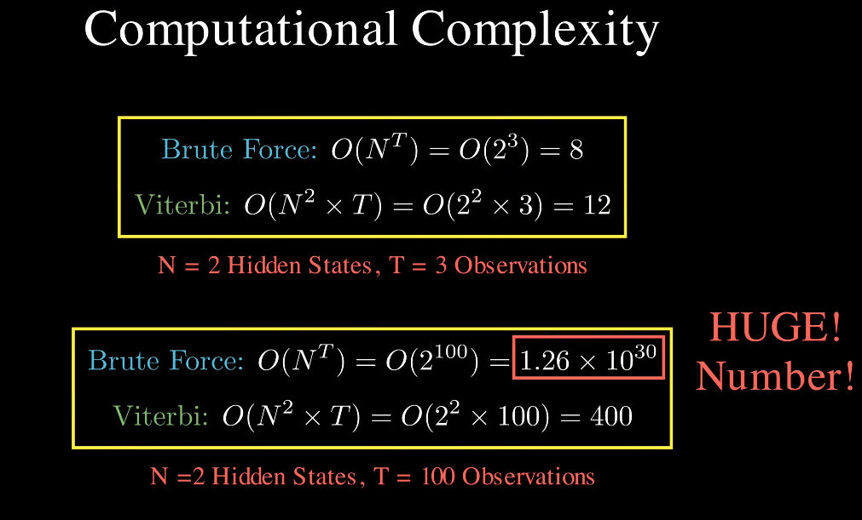
Notes:
You have N possible current states (j)
For each one, you compare N previous states (i)
That’s N × N = N² comparisons per time step.
And since this happens for T time steps,
the total number of computations ≈ N² × T

